Slide 1
Autoencoders and Applications
Radu Ionescu Bogdan Alexe
raducu.ionescu@gmail.com bogdan.alexe@fmi.unibuc.ro
Faculty of Mathematics and Computer Science
University of Bucharest

Slide 2
Agenda
Unsupervised Learning (Introduction)
Autoencoder (AE)
Convolutional AE
Regularization: Sparse
Denoising AE
Stacked AE
Contractive AE
Application: abnormal event detection

Slide 3
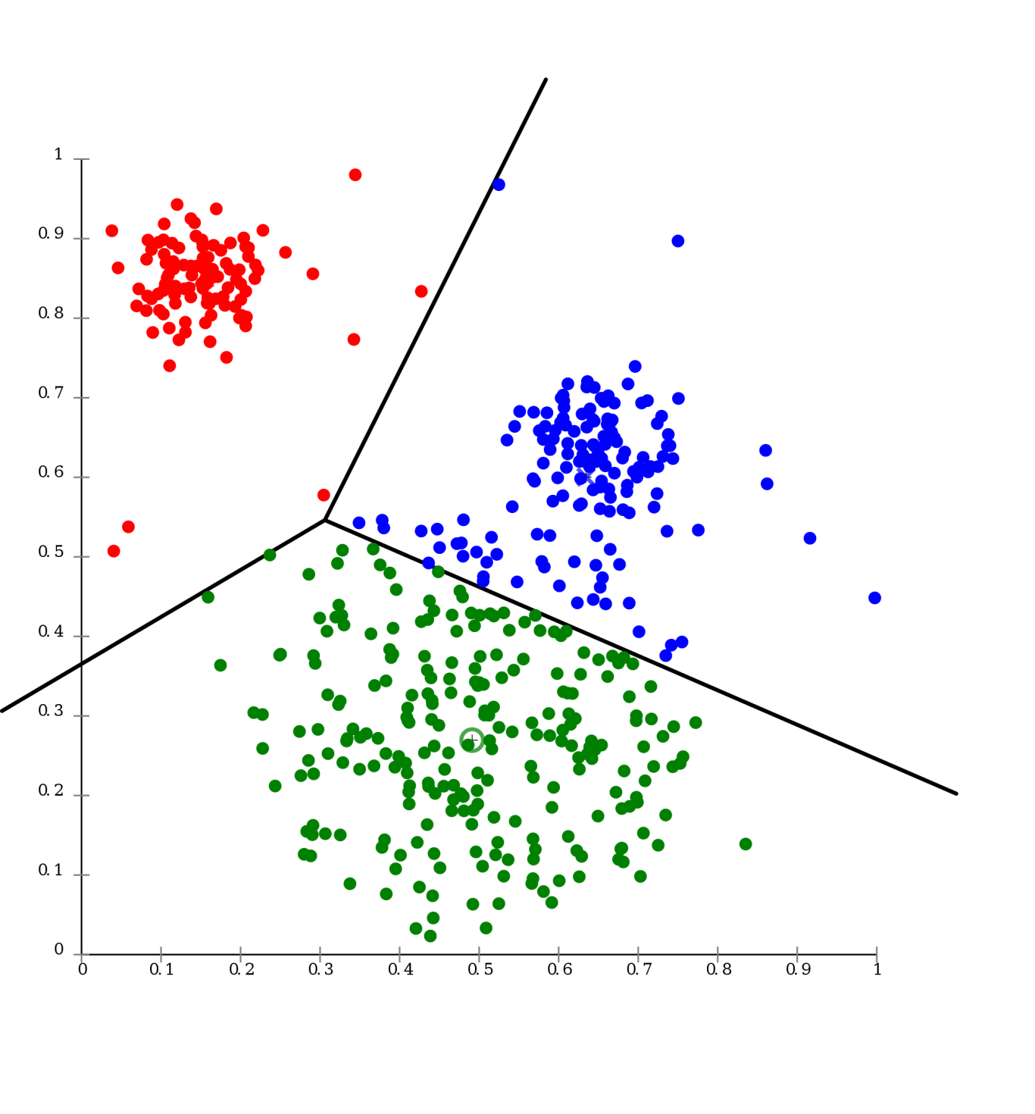
Introduction to Unsupervised Learning

Slide 4
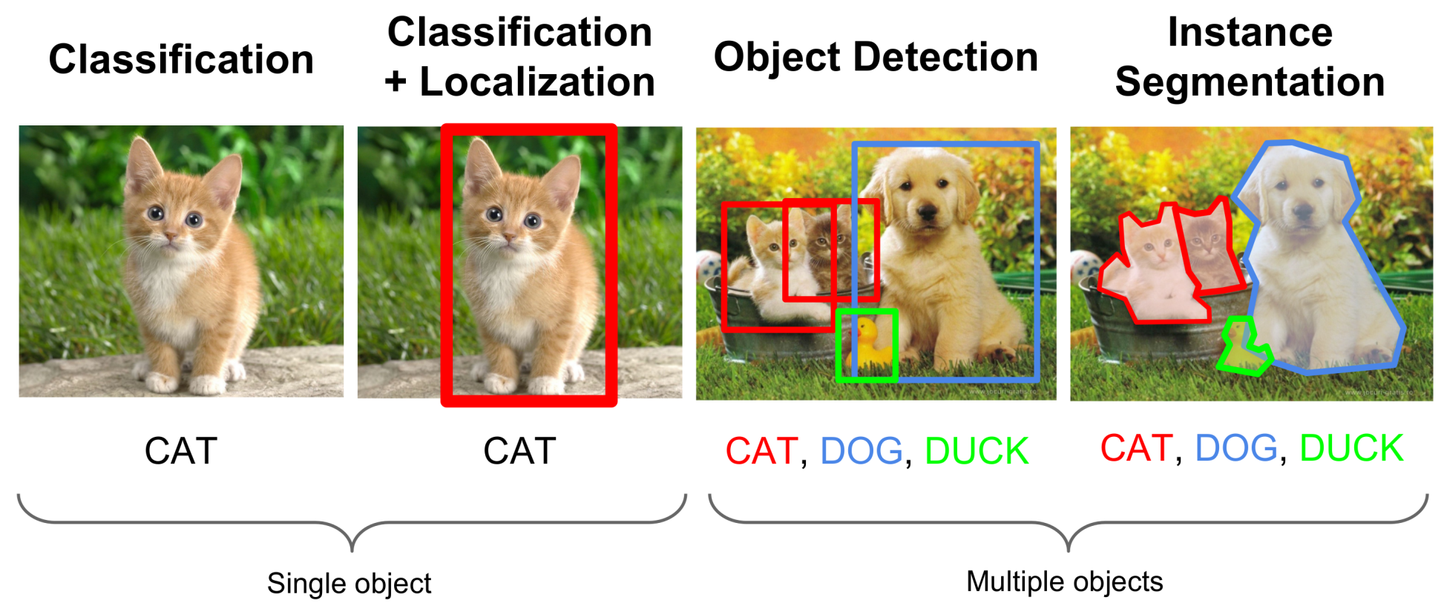
Supervised Learning
Data: (X, Y)
Goal: Learn a Mapping Function f where: f(X) = Y

Slide 5
Supervised Learning
X2
Examples: Classification.
Decision Trees
Naïve Bayes
KNN
SVM
Perceptron
Multi Layer Perceptron
X1
Classification

Slide 6
Supervised Learning
Examples: Regression.
Y
Linear Regression
Ridge Regression
X
Regression

Slide 7
Supervised Learning vs Unsupervised Learning
What happens when our labels are noisy?
01
Missing values.
Labeled incorrectly.
What happens where we don’t have labels for training at all?
02

Slide 8
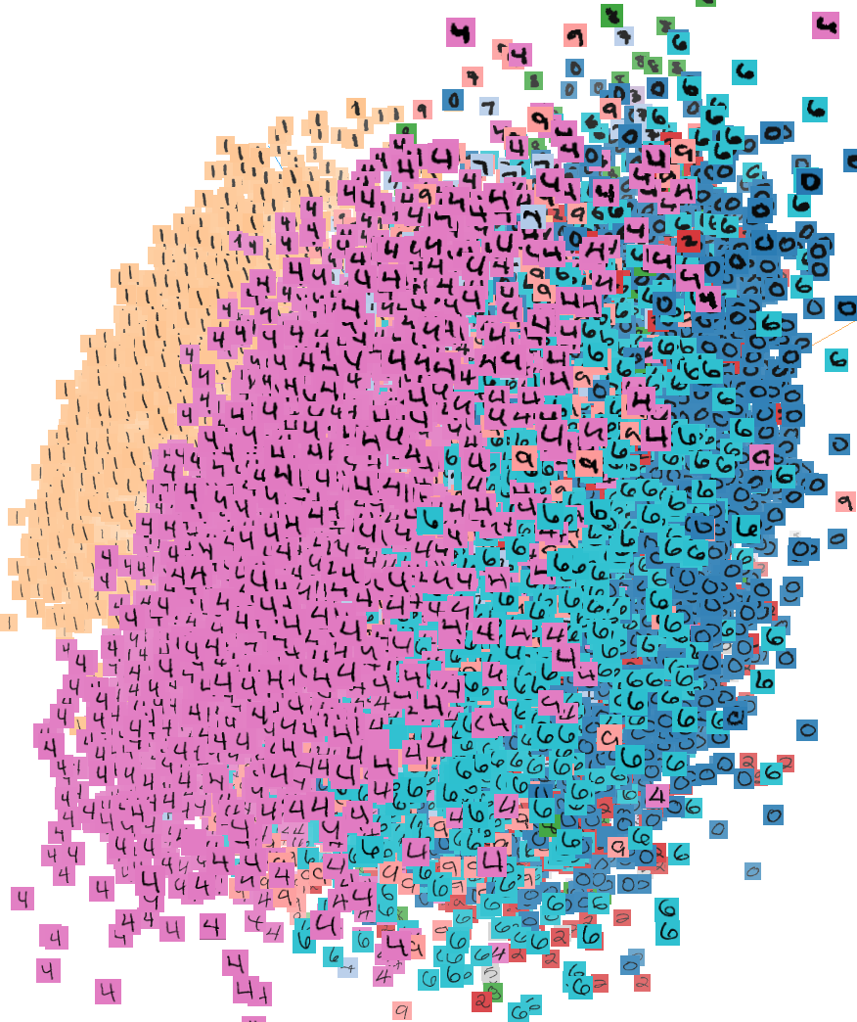
Unsupervised Learning
Data: (X, no labels!)
Goal: Learn the structure of the data
(learn correlations between features)

Slide 9
Unsupervised Learning
Examples:
Clustering
Compression
Feature & Representation learning
Dimensionality reduction
Generative models
etc…

Slide 10
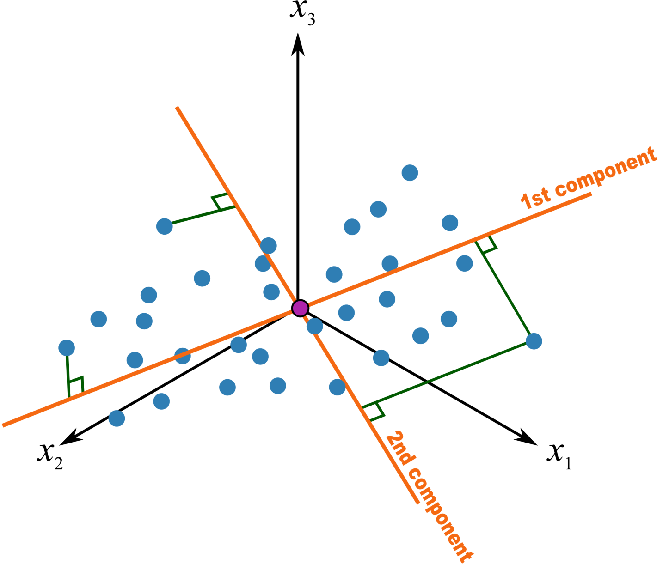
PCA – Principal Component Analysis
Statistical approach for data compression and visualization
Invented by Karl Pearson in 1901
Weakness: linear components only

Slide 11
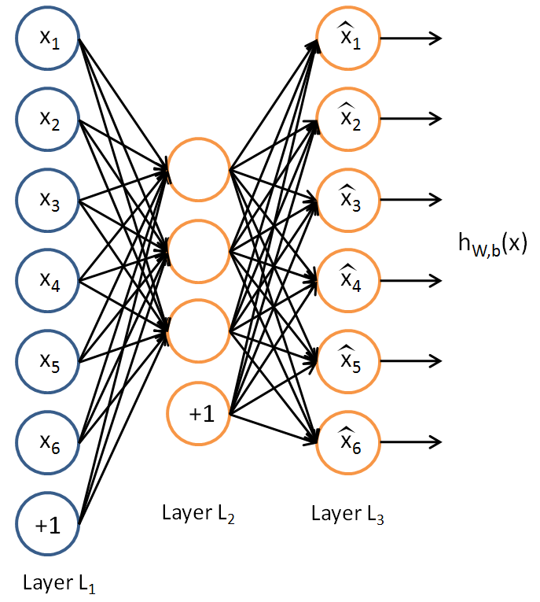
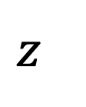
Traditional Autoencoder
Unlike the PCA now we can use activation functions to achieve non-linearity.
It has been shown that an AE without activation functions achieves the PCA capacity.
$$z$$

Slide 12
Applications
The autoencoder idea was a part of NN history for decades (LeCun et al, 1987).
Traditionally an autoencoder is used for dimensionality reduction and feature learning.
Recently, the connection between autoencoders and latent space modeling has brought autoencoders to the front of generative modeling, as we will see in the next lecture.
Not used for compression.
-Data specific compression.
-Lossy.

Slide 13
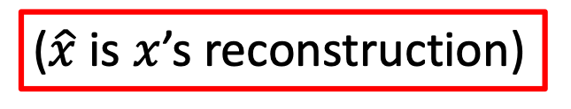
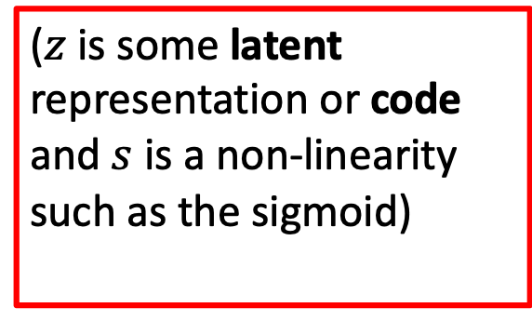

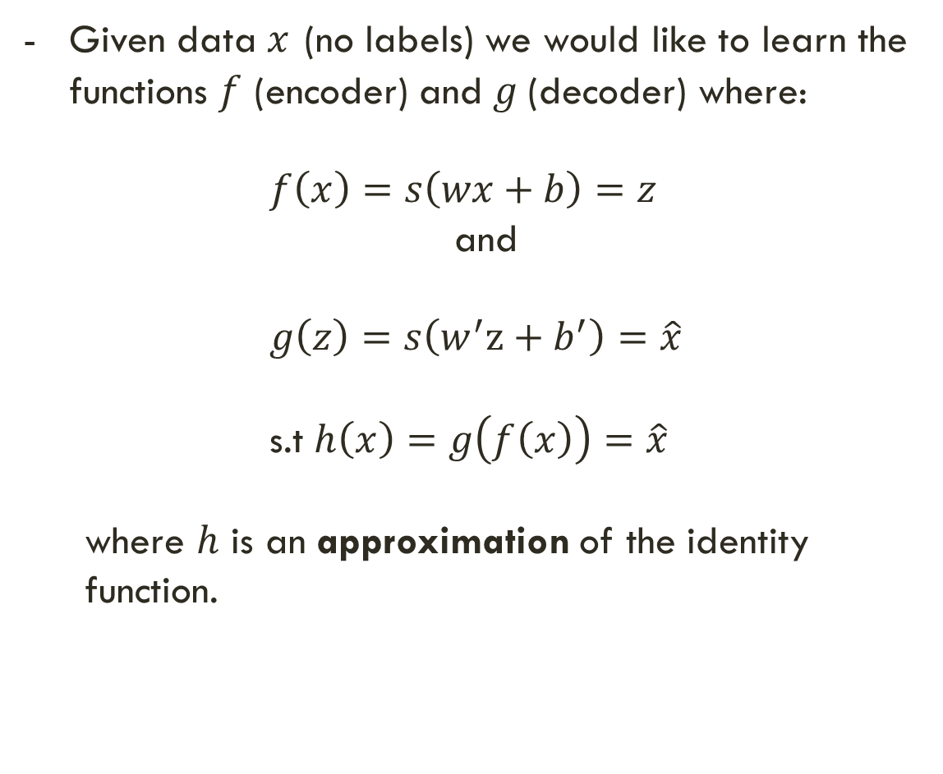

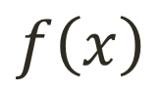


Simple Idea
$$x$$
$$f\left(x\right)$$
$$z$$
$$g\left(z\right)$$
$$\hat{x}$$
Given data $x$ (no labels) we would like to learn the functions $f$ (encoder) and $g$(decoder) where:
$f\left(x\right)=s\left(wx+b\right)=z$
and
$g\left(z\right)=s\left(w^{′}z+b^{′}\right)=\hat{x}$
s.t $h\left(x\right)=g\left(f\left(x\right)\right)=\hat{x}$
where $h$ is an approximation of the identity function.
($z$ is some latent representation or code and $s$ is a non-linearity such as the sigmoid)
($\hat{x}$ is $x$’s reconstruction)

Slide 14
Simple Idea
Learning the identity function seems trivial, but with added constraints on the network (such as limiting the number of hidden neurons or regularization) we can learn information about the structure of the data.
Trying to capture the distribution of the data (data specific!)

Slide 15
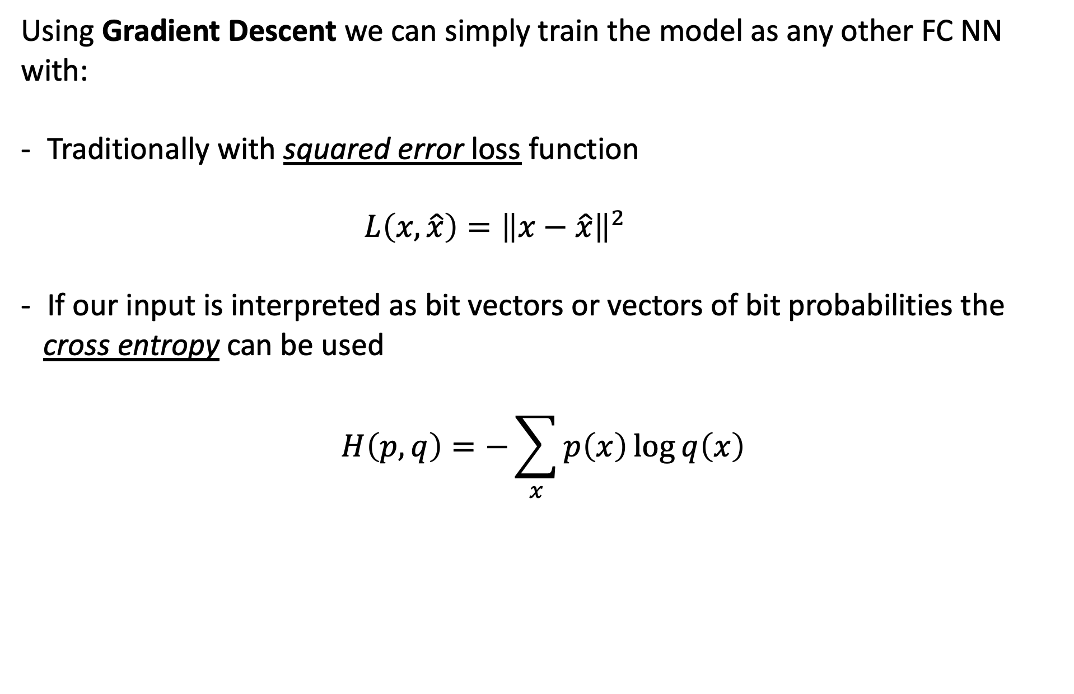
Training the AE
Using Gradient Descent we can simply train the model as any other FC NN with:
Traditionally with squared error loss function
$L\left(x,\hat{x}\right)={\left\|x−\hat{x}\right\|}^{2}$
If our input is interpreted as bit vectors or vectors of bit probabilities the
cross entropy can be used
$$H\left(p,q\right)=−\sum_{x}{p\left(x\right)\log{q\left(x\right)}}$$

Slide 16
Undercomplete AE vs overcomplete AE
We distinguish between two types of AE structures:

Slide 17
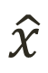
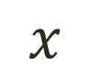
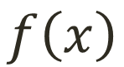
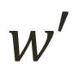

Undercomplete AE
Hidden layer is Undercomplete if smaller than the input layer
Compresses the input
Compresses well only for the training distribution.
$$\hat{x}$$
$$w′$$
$$f\left(x\right)$$
Hidden nodes will be
Good features for the training distribution.
Bad for other types on input
$$w$$
$$x$$

Slide 18
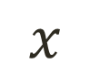
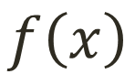


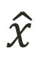
Overcomplete AE
Hidden layer is Overcomplete if greater than the input layer
No compression in hidden layer.
Each hidden unit could copy a different input component.
$$\hat{x}$$
$$w′$$
No guarantee that the hidden units will extract meaningful structure.
$$f\left(x\right)$$
$$w$$
Adding dimensions is good for training a linear classifier (XOR case example).
A higher dimension code helps model a more complex distribution.
$$x$$

Slide 19
Deep Autoencoder Example
https://cs.stanford.edu/people/karpathy/convnetjs/demo/autoencoder.html - By Andrej Karpathy

Slide 20



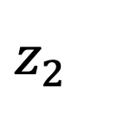
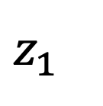
Simple latent space interpolation
$$z_{1}$$
Encoder
$$z_{2}$$
Encoder

Slide 21

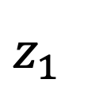
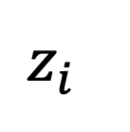
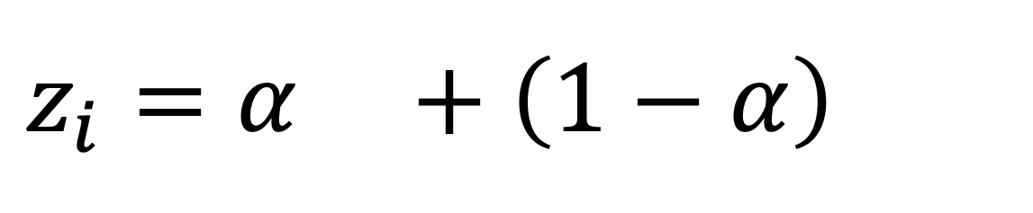
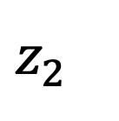
Simple latent space interpolation
$$z_{1}$$
$$z_{2}$$
$$z_{i}=α +\left(1−α\right)$$
$$z_{i}$$
Decoder

Slide 22
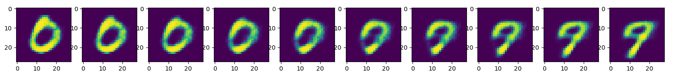
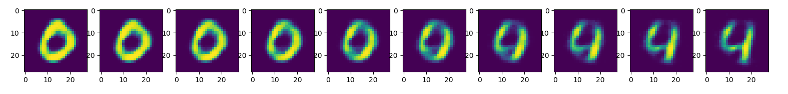
Simple latent space interpolation

Slide 23
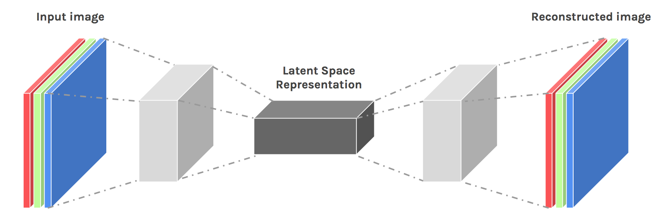
Convolutional AE

Slide 24
Convolutional AE
Input values are normalized
All of the conv layers activation functions are ReLU except for the last conv which is sigmoid
Output
Input
(28,28,1)
C1
(28,28,16)
M.P1
(14,14,16)
C2
(14,14,8)
M.P2
(7,7,8)
C3
(7,7,8)
M.P3
(4,4,8)
D.C1
(4,4,8)
U.S1
(8,8,8)
D.C2
(8,8,8)
U.S2
(16,16,8)
D.C3
(14,14,16)
U.S3
(28,28,8)
D.C4
(28,28,1)
Conv 1
16 F
@ (3,3,1)
same
M.P 1
(2,2)
same
Conv 2
8 F
@ (3,3,16)
same
M.P 2
(2,2)
same
Conv 3
8 F
@ (3,3,8)
same
M.P 3
(2,2)
same
D Conv 1
8 F
@ (3,3,8)
same
U.S 1
(2,2)
D Conv 2
8 F
@ (3,3,8)
same
U.S 2
(2,2)
D Conv 3
16 F
@ (3,3,8)
valid
U.S 3
(2,2)
D Conv 4
1 F
@ (5,5,8)
same
Hidden Code
Encoder
Decoder

Slide 25
Transposed Convolution (Deconvolution)
Stride=1
Pad=Valid
Stride=2
Pad=Valid
Stride=2
Pad=Same
Output
Conv
Input
Output
Deconv
Input
https://github.com/vdumoulin/conv_arithmetic

Slide 26
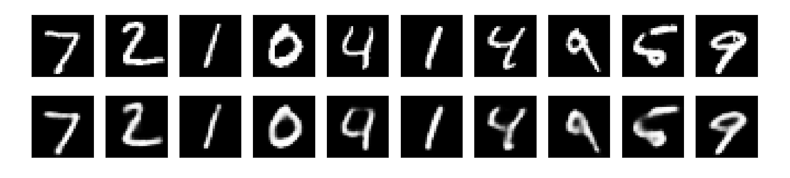
Convolutional AE results
- 50 epochs.
- 88% accuracy on validation set.

Slide 27
Regularization
Motivation:
We would like to learn meaningful features without altering the code’s dimensions (Overcomplete or Undercomplete).
The solution: imposing other constraints on the network.

Slide 28
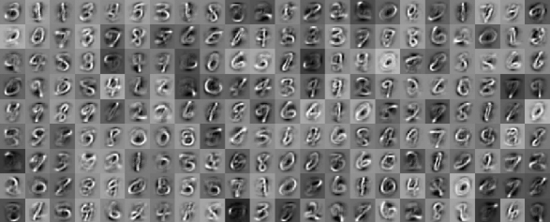
Sparsely Regulated Autoencoders
Activation Maps
A bad example:

Slide 29
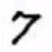
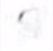

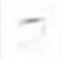
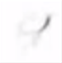
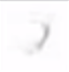

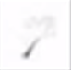

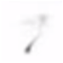
Sparsely Regulated Autoencoders
We want our learned features to be as sparse as possible.
With sparse features we can generalize better.
= 1*
+ 1*
+ 1*
+ 1*
+ 1*
+ 1*
+ 1*
+ 0.8*
+ 0.8*

Slide 30

Sparsely Regulated Autoencoders
Let’s define:
$a_{j}^{\left(Bn\right)}$ to be the activation of the $j$-th hidden unit (bottleneck) of the autoencoder.
$a_{j}^{\left(Bn\right)}\left(x\right)$ to be the activation of this specific node on a given input $x$.

Slide 31
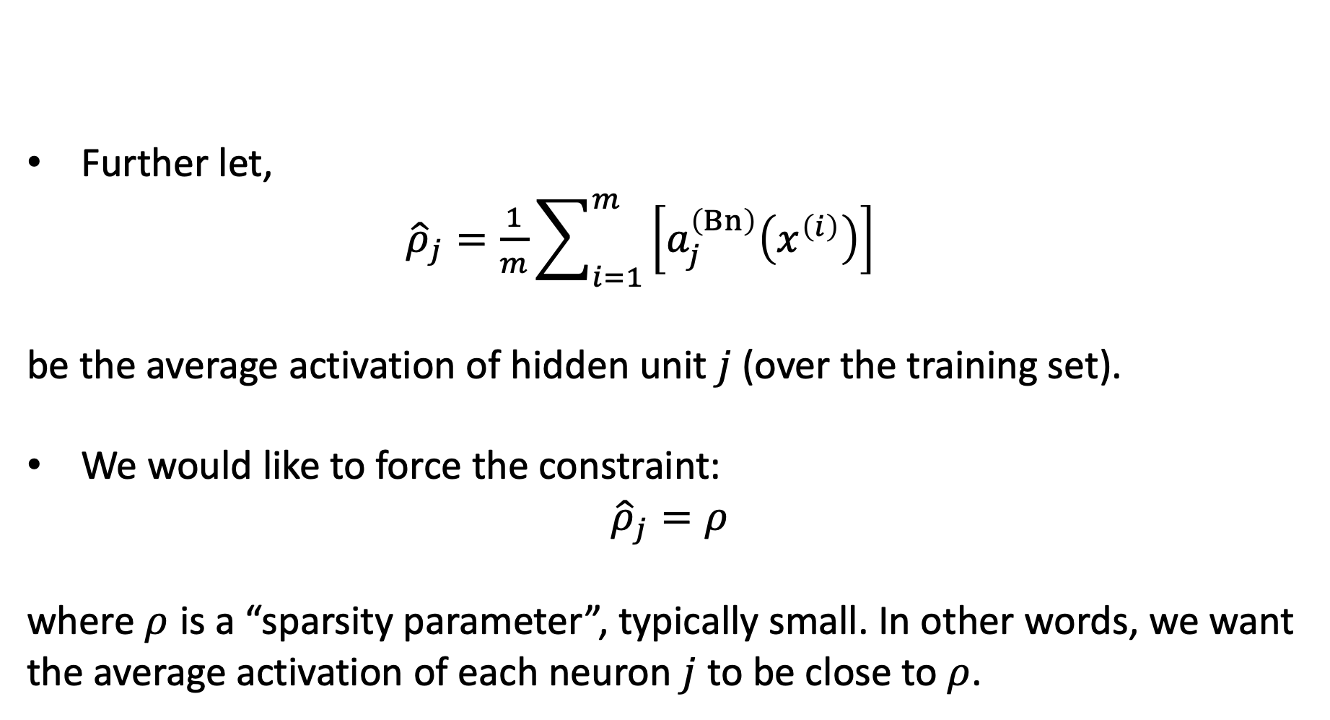
Sparsely Regulated Autoencoders
Further let,
${\hat{ρ}}_{j}=\frac{1}{m}\sum_{i=1}^{m}{\left[a_{j}^{\left(Bn\right)}\left(x^{\left(i\right)}\right)\right]}$
be the average activation of hidden unit $j$ (over the training set).
We would like to force the constraint:
$${\hat{ρ}}_{j}=ρ$$
where $ρ$ is a “sparsity parameter”, typically small. In other words, we want the average activation of each neuron $j$ to be close to $ρ$.

Slide 32
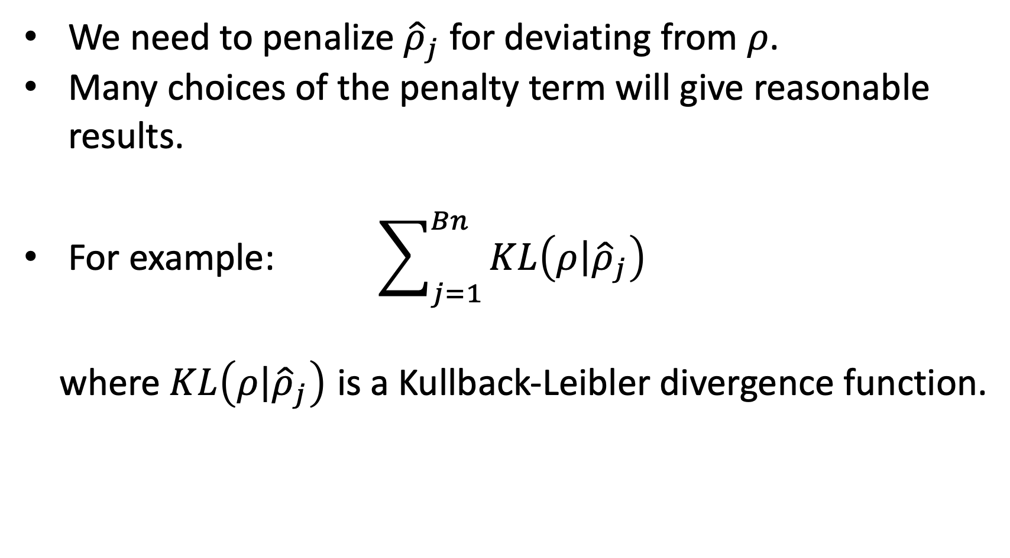
Sparsely Regulated Autoencoders
We need to penalize ${\hat{ρ}}_{j}$ for deviating from $ρ$.
Many choices of the penalty term will give reasonable results.
For example: $\sum_{j=1}^{Bn}{KL\left(\left.ρ\right|{\hat{ρ}}_{j}\right)}$
where $KL\left(\left.ρ\right|{\hat{ρ}}_{j}\right)$ is a Kullback-Leibler divergence function.

Slide 33
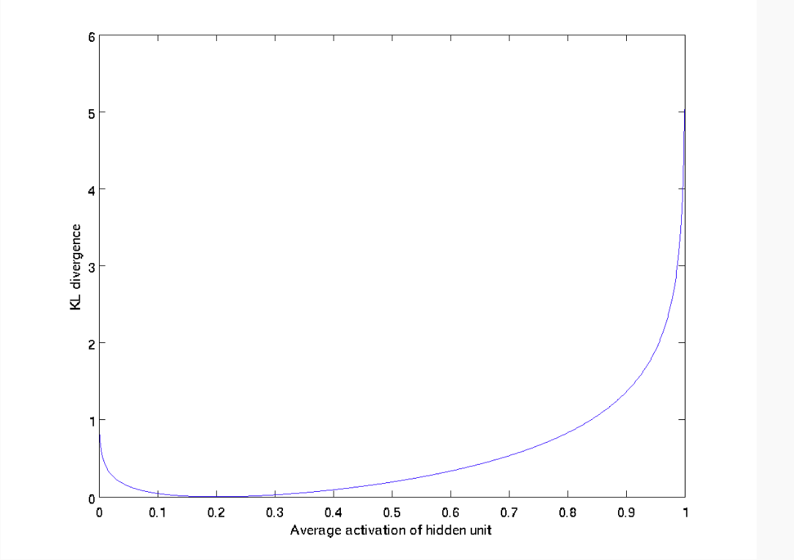

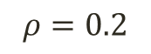
Sparsely Regulated Autoencoders
A reminder:
KL is a standard function for measuring how different two distributions are, which has the properties:
$KL\left(\left.ρ\right|{\hat{ρ}}_{j}\right)$ = 0 if ${\hat{ρ}}_{j}=ρ$
otherwise it is increased monotonically.
$$ρ=0.2$$

Slide 34
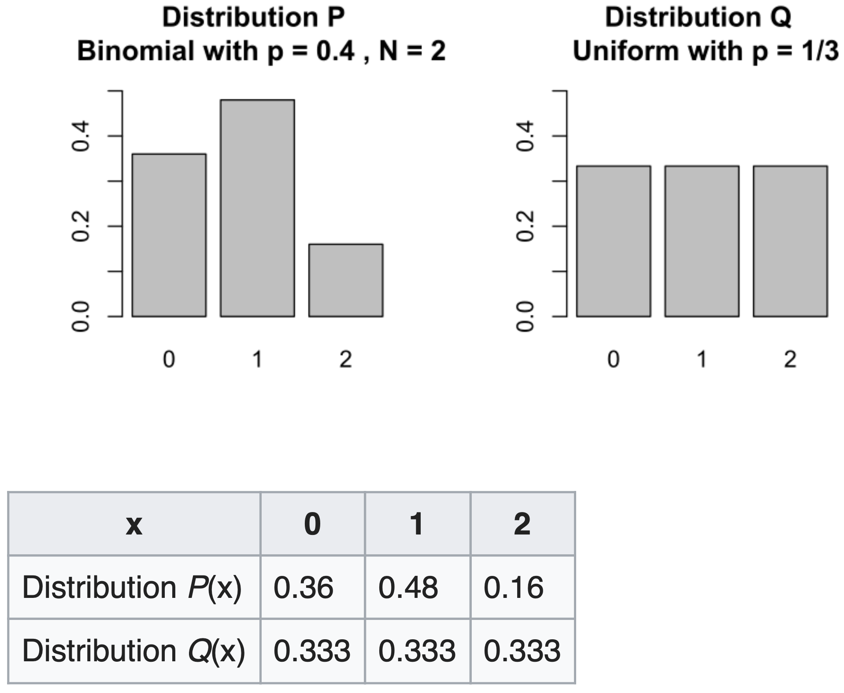
Kullback-Leibler Divergence

Slide 35
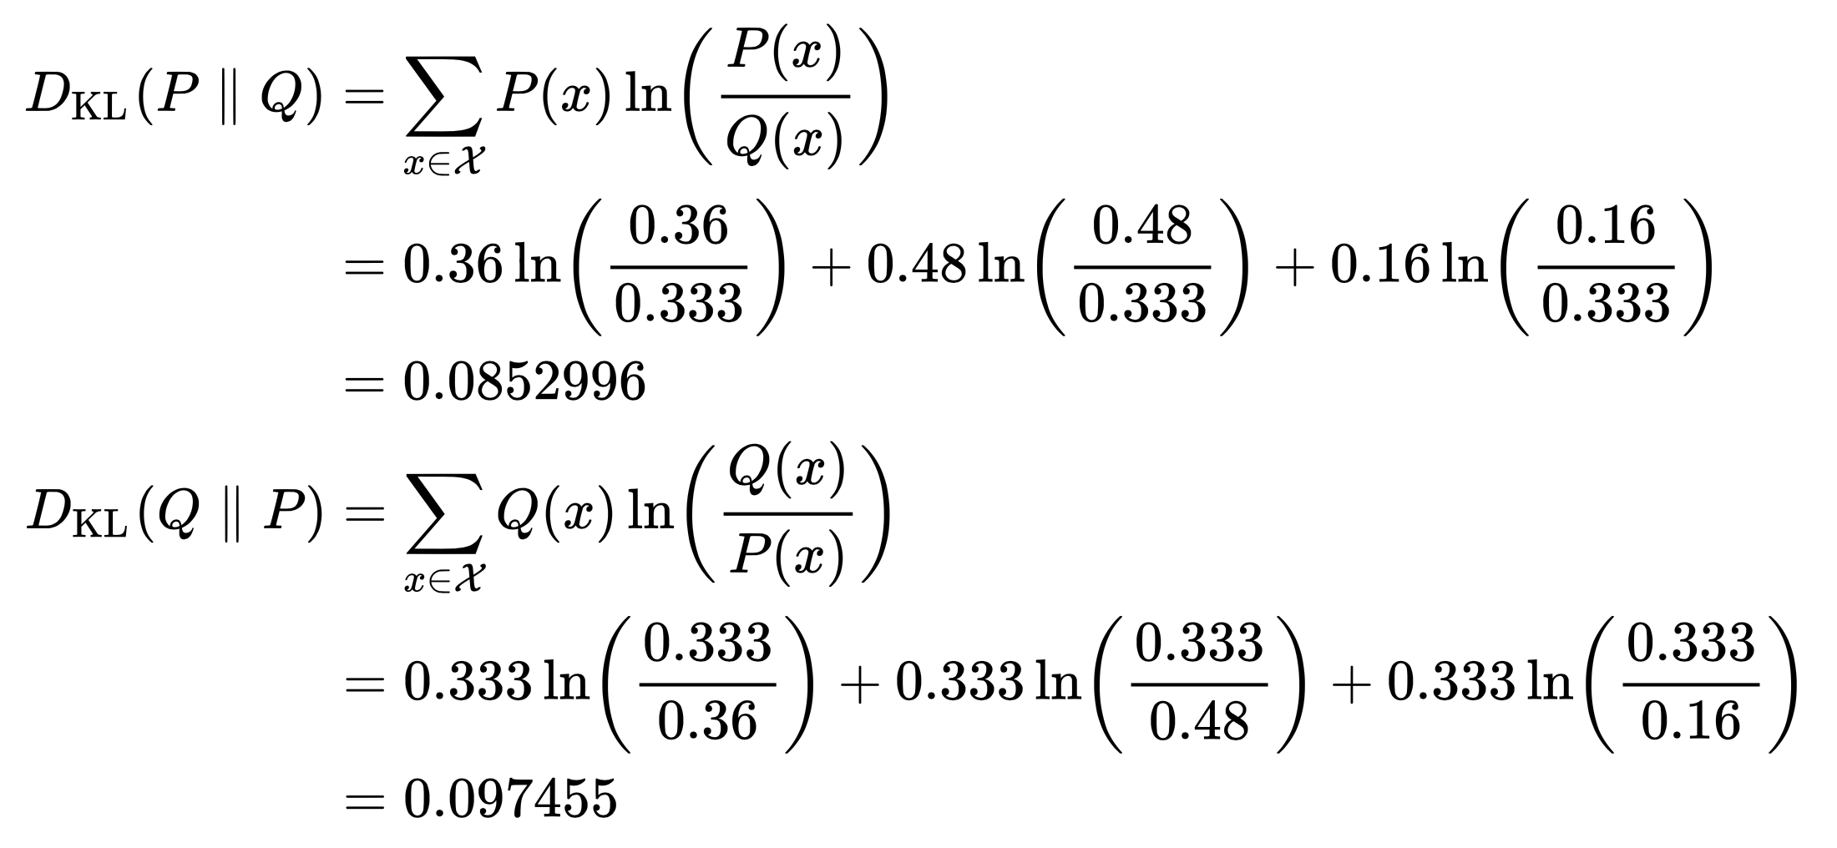
Kullback-Leibler Divergence

Slide 36
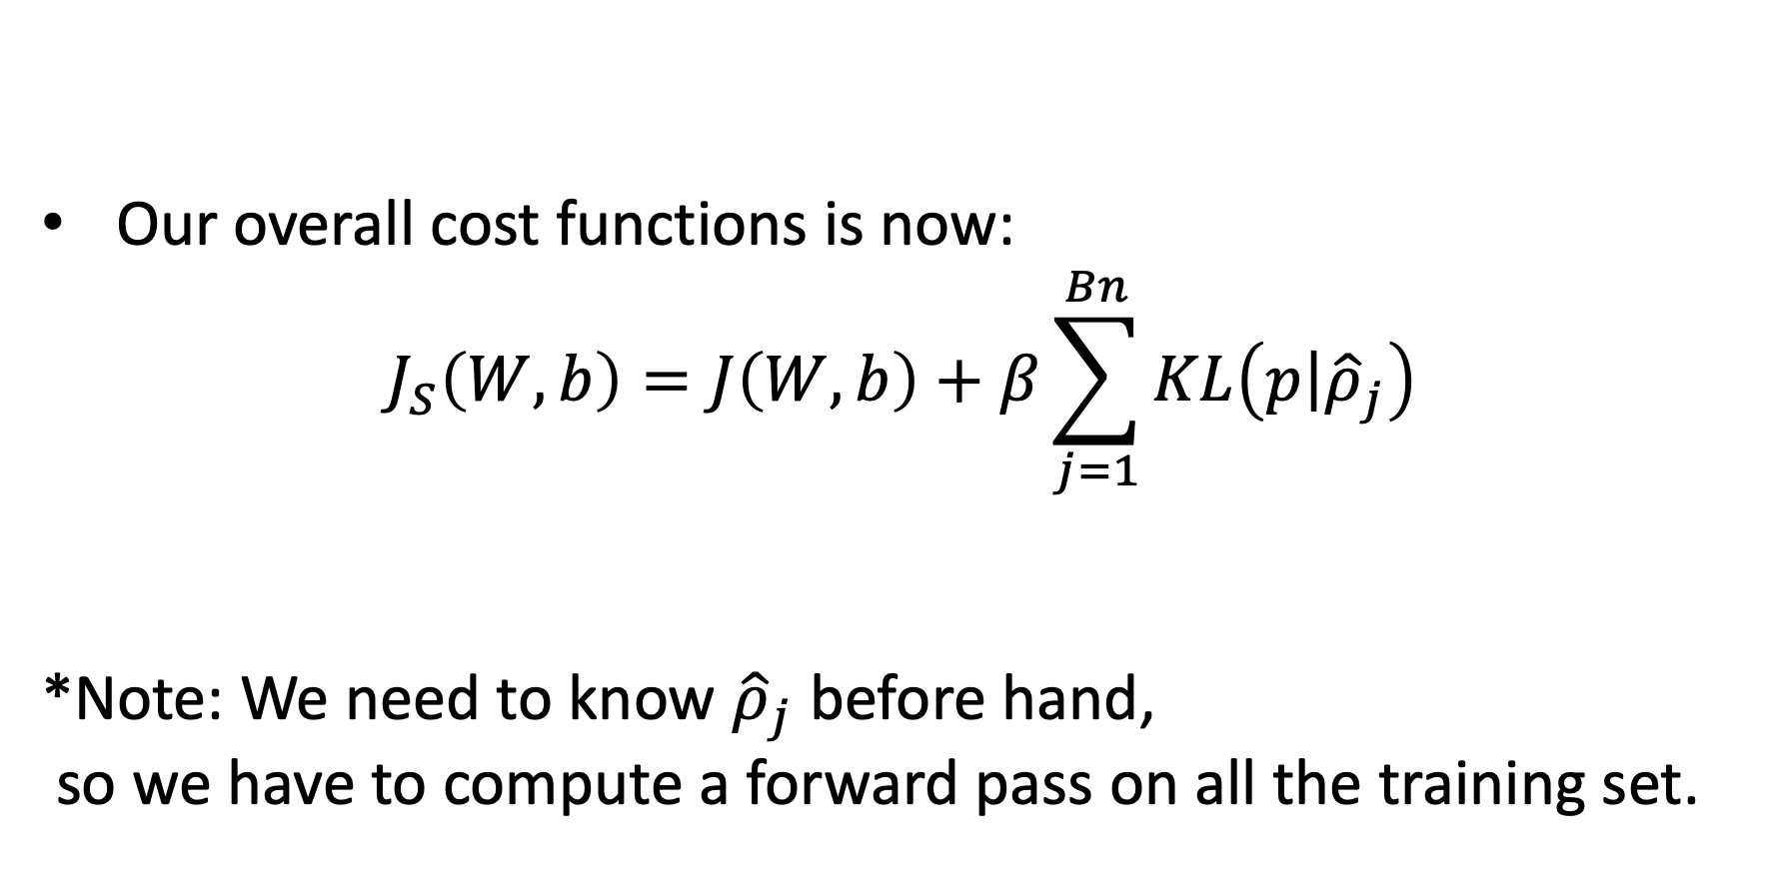
Sparsely Regulated Autoencoders
Our overall cost functions is now:
$$J_{S}\left(W,b\right)=J\left(W,b\right)+β\sum_{j=1}^{Bn}{KL\left(\left.p\right|{\hat{ρ}}_{j}\right)}$$
*Note: We need to know ${\hat{ρ}}_{j}$ before hand,
so we have to compute a forward pass on all the training set.

Slide 37
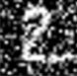

Denoising Autoencoders
Intuition:
We still aim to encode the input and to NOT mimic the identity function.
We try to undo the effect of corruption process stochastically applied to the input.
A more robust model
Encoder
Decoder
Noisy Input
Denoised Input
Latent space representation

Slide 38

Denoising Autoencoders
Use Case:
Extract robust representation for a NN classifier.
Encoder
Noisy Input
Latent space representation

Slide 39


Denoising Autoencoders
Instead of trying to mimic the identity function by minimizing:
$L\left(x,g\left(f\left(x\right)\right)\right)$
where L is some loss function
A DAE instead minimizes:
$L\left(x,g\left(f\left(\tilde{x}\right)\right)\right)$
where $\tilde{x}$ is a copy of $x$ that has been corrupted by some form of noise.

Slide 40







Denoising Autoencoders
Idea: A robust representation against noise:
Random assignment of subset of inputs to 0, with probability $v$.
Gaussian additive noise.
$$\hat{x}$$
$$w′$$
$$f\left(x\right)$$
$$w$$
$$x$$

Slide 41









Denoising Autoencoders
$$\hat{x}$$
Reconstruction $\hat{x}$ computed from the corrupted input $\tilde{x}$.
Loss function compares $\hat{x}$ reconstruction with the noiseless $x$.
$$w′$$
$$f\left(\tilde{x}\right)$$
The autoencoder cannot fully trust each feature of $x$ independently so it must learn the correlations of $x$’s features.
Based on those relations we can predict a more “not prone to changes” model.
We are forcing the hidden layer to learn a generalized structure of the data.
$$w$$
$$\tilde{x}$$
0
0
0
Noise Process
$$p\left(\left.\tilde{x}\right|x\right)$$
$$x$$

Slide 42




Denoising Autoencoders: process
Taken some input $x$
Apply Noise
$$\tilde{x}$$

Slide 43


Denoising Autoencoders: process
DAE
$$\tilde{x}$$
Encode And Decode
DAE
$$g\left(f\left(\tilde{x}\right)\right)$$

Slide 44



Denoising Autoencoders: process
DAE
DAE
$$g\left(f\left(\tilde{x}\right)\right)$$
$$\hat{x}$$

Slide 45


Denoising Autoencoders: process
Compare
$$x$$
$$\hat{x}$$

Slide 46

Denoising Autoencoders

Slide 47

Denoising Convolutional AE results
- 50 epochs.
- Noise factor 0.5.
- 92% accuracy on validation set.

Slide 48
Stacked AE
Motivation:
We want to harness the feature extraction quality of a AE for our advantage.
For example: we can build a deep supervised classifier where its input is the output of a SAE.
The benefit: our deep model’s W are not randomly initialized but are rather “smartly selected”
Also using this unsupervised technique lets us have a larger unlabeled dataset.

Slide 49
Stacked AE
Building a SAE consists of two phases:
1. Train each AE layer one after the other.
2. Connect any classifier (SVM / FC NN layer etc.)

Slide 50


Stacked AE
SAE
Classifier
$$x$$
$$y$$

Slide 51



Stacked AE: process
First Layer Training (AE 1)
$$x$$
$$f_{1}\left(x\right)$$
$$z_{1}$$
$$g_{1}\left(z_{1}\right)$$
$$\hat{x}$$

Slide 52





Stacked AE: process
Second Layer Training (AE 2)
$$x$$
$$f_{1}\left(x\right)$$
$$z_{1}$$
$$f_{2}\left(z_{1}\right)$$
$$z_{2}$$
$$g_{2}\left(z_{2}\right)$$
$${\hat{z}}_{1}$$

Slide 53

Stacked AE: process
Add any classifier
Classifier
$$x$$
$$f_{1}\left(x\right)$$
$$z_{1}$$
$$f_{2}\left(z_{1}\right)$$
$$z_{2}$$
Output

Slide 54

Autoencoders: applications
Image colorization: input black and white and train to produce color images

Slide 55

Autoencoders: applications
Watermark removal

Slide 56
Object-centric Auto-encoders and Dummy Anomalies for Abnormal Event Detection in Video
RT Ionescu, FS Khan, MI Georgescu, L Shao
CVPR 2019

Slide 57


Abnormal event detection
Abnormal event detection in video is a challenging task
What an abnormal event looks like depends on the context!
Examples:
car driving by on the street versus car driving in a pedestrian area
person jogging versus person running outside a bank
Notes:
Notes:
The task is ill-defined

Slide 58
Problem definition
Hard to find a sufficiently representative set of anomalies
=> Traditional supervised learning methods are ruled out
Hypothesis: Abnormal events should be unexpected events that occur less often than familiar (normal) events
=> Normal events can be easily collected for training
=> Usually formalized as outlier detection
Notes:
Notes:
One
Two

Slide 59
Common approaches
Usual abnormal event detection approaches learn a model of familiarity from training videos and label events as abnormal if they deviate from the model
A few approaches (unsupervised) do not require any training data
Notes:
Notes:
One
Two

Slide 60

Notes:
This figure illustrates our pipeline
During training, we apply a two-stage outlier detection algorithm based on k-means and one-class SVM
We eliminate the smaller k-means clusters as outliers, and, for each remaining cluster, we shrink the borders using one-class SVM
During inference, we label a test sample as abnormal if its maximum normality score among the scores provided by the trained one-class SVM models is negative

Slide 61


Slide 62
Data Sets
Avenue [Lu et al, ICCV13]
Subway [Adam et al, PAMI08]
ShanghaiTech [Luo et al., ICCV 2017]
UMN [Mehran et al, CVPR09]
Area under the ROC curve (AUC) computed with respect to:
ground-truth frame-level annotations
Evaluation Metrics
Notes:
We compare our approach with several state-of-the-art methods on three data sets: Avenue, Subway and UMN
As evaluation metrics, we employ the Area under the ROC curve (AUC) computed with respect to ground-truth frame-level annotations and, when available, ground-truth pixel-level annotations

Slide 63

Preliminary results on ShanghaiTech
Notes:
We compare our approach with several state-of-the-art methods on three data sets: Avenue, Subway and UMN
As evaluation metrics, we employ the Area under the ROC curve (AUC) computed with respect to ground-truth frame-level annotations and, when available, ground-truth pixel-level annotations

Slide 64

Notes:
We compare our approach with several state-of-the-art methods on three data sets: Avenue, Subway and UMN
As evaluation metrics, we employ the Area under the ROC curve (AUC) computed with respect to ground-truth frame-level annotations and, when available, ground-truth pixel-level annotations

Slide 65


Slide 66

Video example for anomaly localization

Slide 67
Remarks
Better results by training deep auto-encoder features than using pre-trained CNN features
Focusing on objects helps to improve accuracy over state-of-the-art
Including one-versus-rest supervision is very useful

